Slide 1
JAVA

Slide 2
Java applications
Java is used to develop lots of applications in that the main applications are WAR,EAR and Mobile applications.
Web-based Applications
Java is also used to develop web applications. It provides a vast support for web applications through Servlets or JSPs. With the help of these technologies, you can develop any kind of web application that you require. The easy coding and high security offered by this programming language allow the development of a large number of applications for health, social security, education, and insurance.
Enterprise Applications
Java is the first choice of many software developers for writing applications and Java Enterprise Edition (Java EE) is a very popular platform that provides API and runtime environment for scripting. It also includes network applications and web-services. JavaEE is also considered as the backbone for a variety of banking applications which have Java running on the UI to back server end.

Slide 3
Mobile Applications
Java is considered as the official programming language for mobile app development. It is compatible with software such as Android Studio . The reason is that it can run on Java Virtual Machine(JVM), to execute class files. These files are further bundled as Android application Package(APK). With Java and its OOPs principles, it provides better security and ease of simplicity with Android.
Business Applications:
These applications are designed to solve the problems encountered by large enterprises. The features that make enterprise applications powerful, like security and reliability, often make these applications complex. The Java EE platform reduces the complexity of enterprise application development by providing a development model, API, and runtime environment that allow developers to concentrate on functionality.

Slide 4
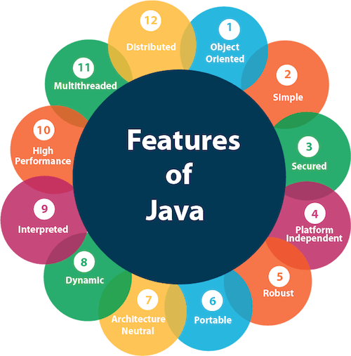
Features of java

Slide 5
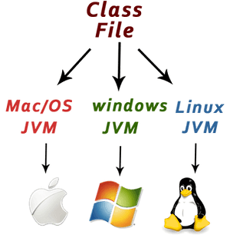
Simple
Java is very easy to learn, and its syntax is simple, clean and easy to understand.
Java syntax is based on C++ (so easier for programmers to learn it after C++).
Java has removed many complicated and rarely-used features, for example explicit pointers, operator overloading, etc.
There is no need to remove unreferenced objects because there is an Automatic Garbage Collection in Java.
Object-oriented
Java is an object-oriented programming language. Everything in Java is an object. Object-oriented means we organize our software as a combination of different types of objects that incorporate both data and behavior.
Platform Independent
Java code can be executed on multiple platforms, for example, Windows, Linux, Sun Solaris, Mac/OS, etc. Java code is compiled by the compiler and converted into bytecode. This bytecode is a platform-independent code because it can be run on multiple platforms, i.e., Write Once and Run Anywhere (WORA).

Slide 6
Secured
Java is best known for its security. With Java, we can develop virus-free systems. Java is secured because:
No explicit pointer
Classloader: Classloader in Java is a part of the Java Runtime Environment (JRE) which is used to load Java classes into the Java Virtual Machine dynamically.
Bytecode Verifier: It checks the code fragments for illegal code that can violate access rights to objects.
Robust
The English meaning of Robust is strong. Java is robust because:
It uses strong memory management.
There is a lack of pointers that avoids security problems.
Java provides automatic garbage collection which runs on the Java Virtual Machine to get rid of objects which are not being used by a Java application anymore.
There are exception handling and the type checking mechanism in Java. All these points make Java robust.
Architecture-neutral
Java is architecture neutral because there are no implementation dependent features, for example, the size of primitive types is fixed.

Slide 7
Portable
Java is portable because it facilitates you to carry the to any platform. It doesn't require any implementation.
High-performance
Java is faster than other traditional interpreted programming languages because Java bytecode is "close" to native code. It is still a little bit slower than a compiled language (e.g., C++). Java is an interpreted language that is why it is slower than compiled languages, e.g., C, C++, etc.
Distributed
Java is distributed because it facilitates users to create distributed applications in Java. This feature of Java makes us able to access files by calling the methods from any machine on the internet.
Multi-threaded
A thread is like a separate program, executing concurrently. We can write Java programs that deal with many tasks at once by defining multiple threads. The main advantage of multi-threading is that it doesn't occupy memory for each thread. It shares a common memory area. Threads are important for multi-media, Web applications, etc.
Dynamic
Java is a dynamic language. It supports the dynamic loading of classes. It means classes are loaded on demand. It also supports functions from its native languages, i.e., C and C++.

Slide 8
Why Java is secure?
Java virtual machine plays a fundamental role to verify the byte-code. The task of JVM is to check that the program is not making any unsafe operations. There are cases when a program jumps to wrong locations that can hold malicious data.
Security Manager
Security manager guarantees that the doubted code or some malicious code does not accomplish the goal of accessing some features of the platform and API’s
Void of Pointers
There is no concept of pointers in Java language. The only disadvantage of pointers is that it can be used to refer another object for doing some unauthorized read and write operation. This puts the feature of security in Java in jeopardy. Hence, there are no pointers!
Memory management
Java has an automatic garbage collection system. It has its own memory management mechanism. Allowed time users forget to free their memory when the utilization of some objects is done. But in the case of Java, the memory need not be vacated. JVM does your work.
Compile-time checking
For instance if any unauthorized method is trying to access private variable then at compile time JVM fetches error. JVM catches as many errors as it encounters.

Slide 9
Access Modifiers in Java
As the name suggests access modifiers in Java helps to restrict the scope of a class, constructor, variable, method, or data member. There are four types of access modifiers available in java:
Private
Protected
Public
Private: The private access modifier is specified using the keyword private.
The methods or data members declared as private are accessible only within the class in which they are declared.
Any other class of the same package will not be able to access these members.
Top-level classes or interfaces can not be declared as private because
private means “only visible within the enclosing class”.
protected means “only visible within the enclosing class and any subclasses”

Slide 10
protected: The protected access modifier is specified using the keyword protected.
The methods or data members declared as protected are accessible within the same package or subclasses in different packages.
public: The public access modifier is specified using the keyword public.
The public access modifier has the widest scope among all other access modifiers.
Classes, methods, or data members that are declared as public are accessible from everywhere in the program. There is no restriction on the scope of public data members.

Slide 11
Garbage Collection in Java
Garbage collection in Java is the process by which Java programs perform automatic memory management. Java programs compile to bytecode that can be run on a Java Virtual Machine, or JVM for short. When Java programs run on the JVM, objects are created on the heap, which is a portion of memory dedicated to the program.

